Slide 1
Threats to Security
Lecture 5

Slide 2
Threats to Personal Security
Threats to personal security encompass various risks and dangers that can compromise an individual's privacy, data, and overall safety in the digital world. Common threats to personal security are :
Social Engineering
Malware
Identity Theft
Password Attacks
Public Wi-Fi Risks
Lack of Software Updates
Fake Apps and Software
Scams
Physical Theft of Devices
800 × 534

Slide 3
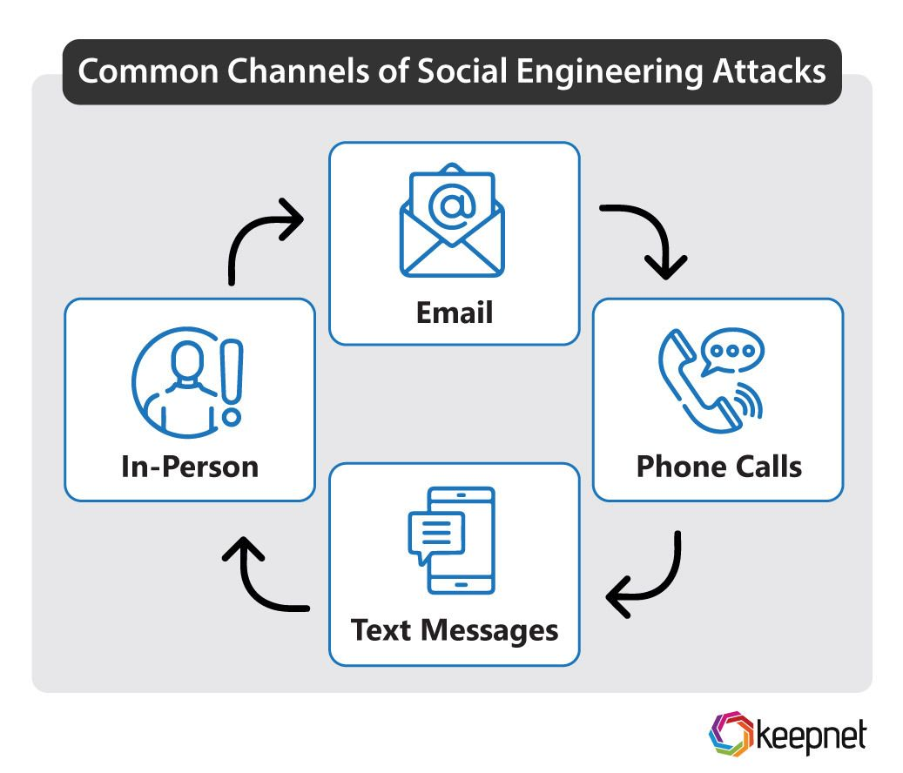
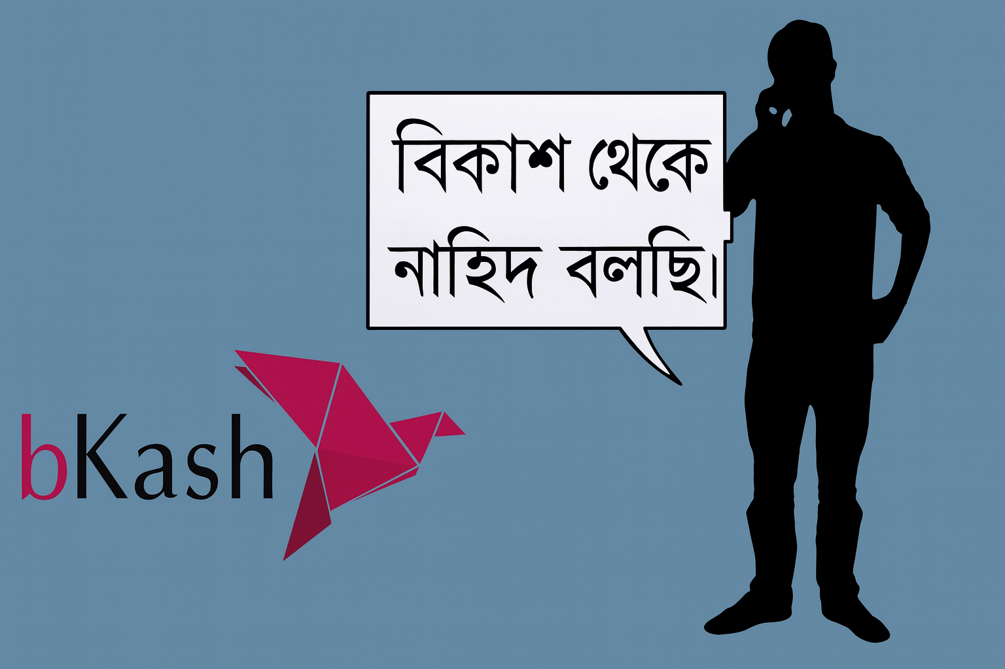
Social Engineering
Attackers manipulate individuals into divulging sensitive information or performing actions that compromise security, often through psychological manipulation.

Slide 4
Social Engineering Attacks
Common Social Engineering Attacks:
Phishing: Fraudulent messages designed to trick individuals into revealing sensitive information.
Spoofing: Deceptive emails or websites that appear legitimate.
Whaling: Targeted phishing aimed at high-ranking executives.
Baiting: Enticing victims with fake offers to install malware or reveal personal information

Slide 5
Preventive Measures Of Public Social Engineering Risks
Be cautious with sharing personal information online and offline
Verify the identity of people requesting sensitive data or access
Be wary of unsolicited emails, calls, or messages asking for personal information
Educate yourself and others about common social engineering tactics
Use strong passwords and enable multi-factor authentication (MFA)
Limit the information shared on social media platforms

Slide 6
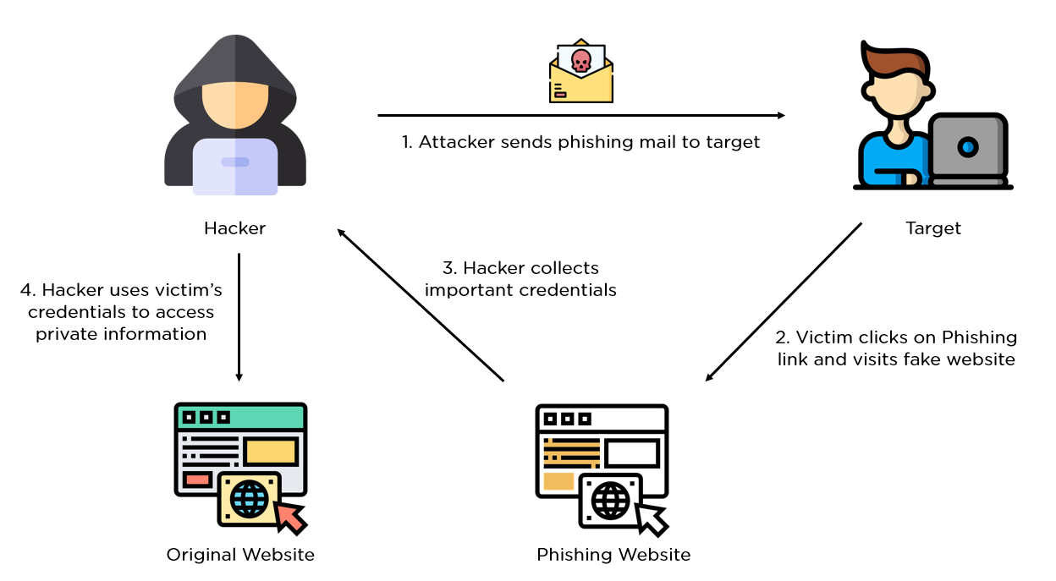
Phishing
Phishing is a social engineering technique where attackers masquerade as trustworthy entities through emails, messages, or websites. They aim to trick users into revealing sensitive information like login credentials, credit card numbers, or personal details.
Example:
-https://faccbook.com/profile.jar/
-https://facebo0k.com/profile.jar/
-https://faecbook.com/profile.jar/
-https://mail.googlc.com/mail/u/0/
-https://mail.google.com.diu.edu.bd/mail/u/0/
-https://youtube.gov.bd/

Slide 7
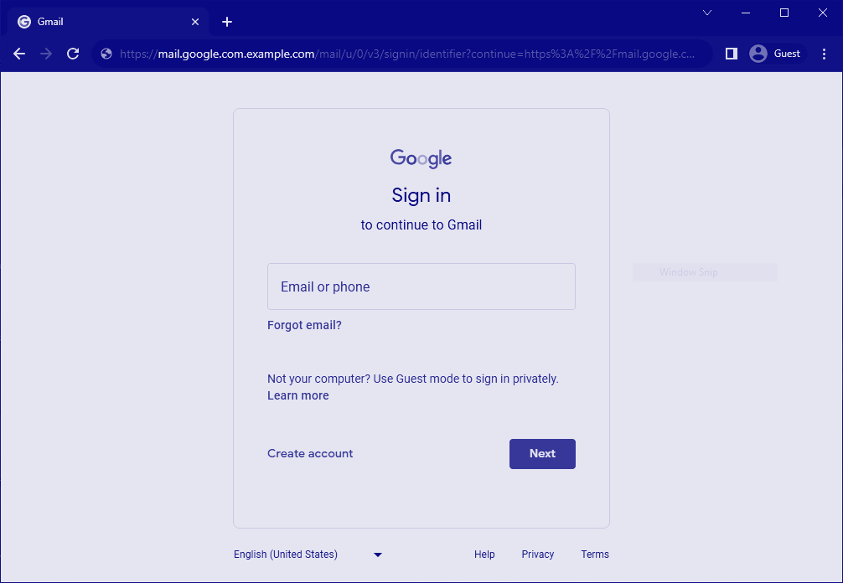
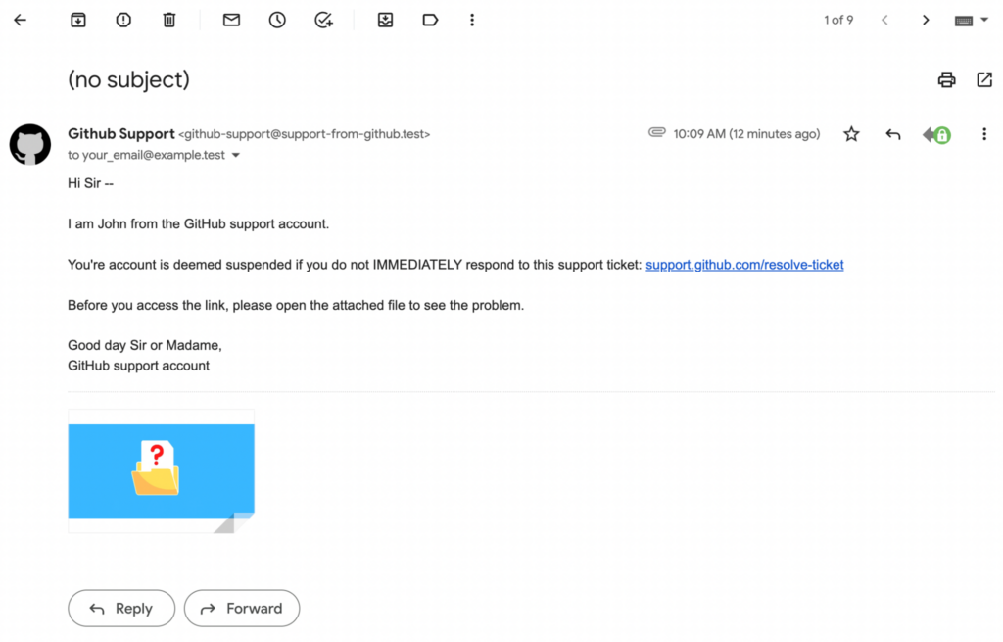
Example: Gmail Phishing

Slide 8
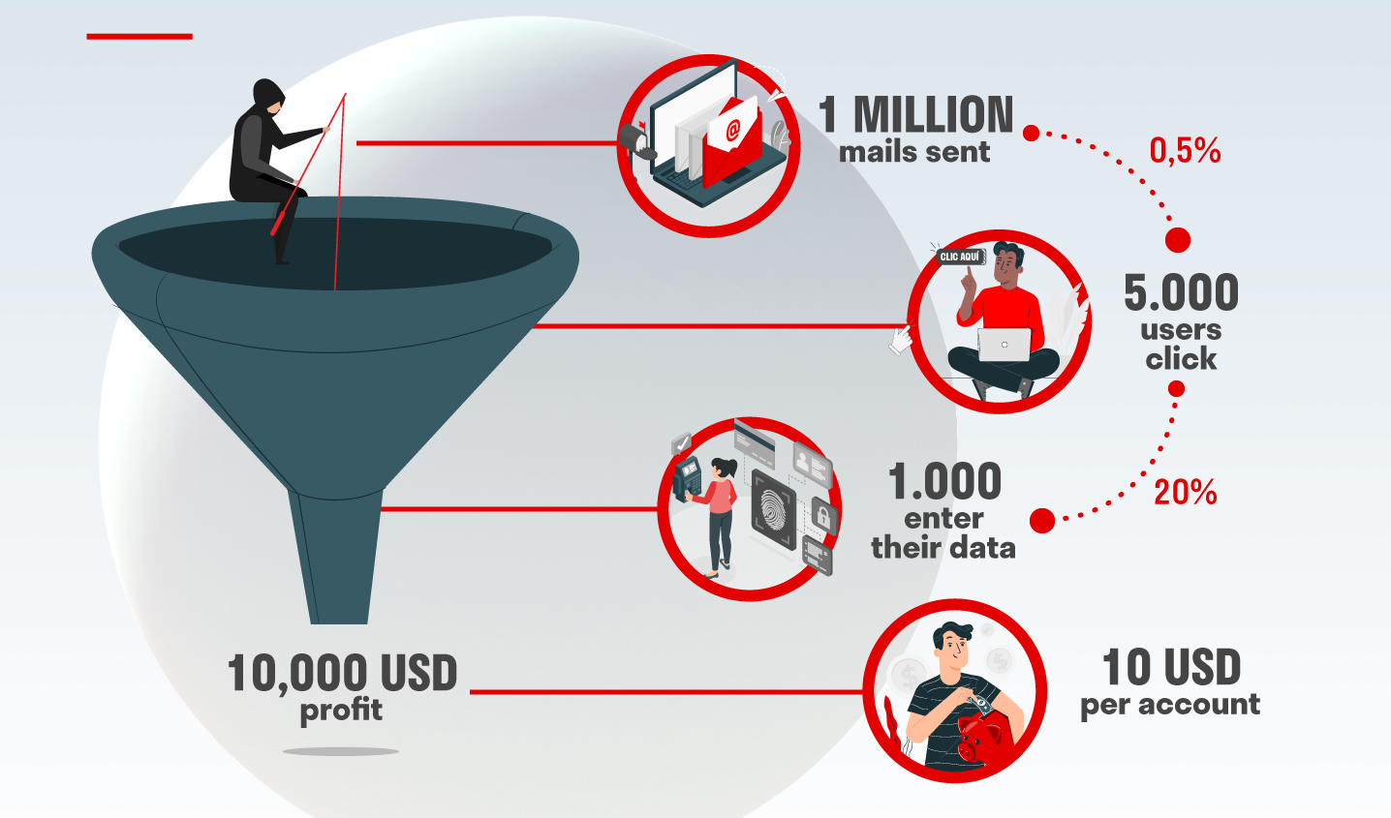
Phishing
Cyber-attacks are like a funnel. Imagine that:
The phisher sends 1,000,000 emails.
Only 0.5% of the users who have received the communication, i.e. 5,000, click on it.
20% of them, i.e. 1,000 people, also enter their data.
In total, in this type of simple attack, 10 USD per account was stolen.
Result: 10,000 USD profit.

Slide 9
Preventive Measures of Phishing Attack
Educate yourself about phishing techniques and common scams.
Be cautious with emails, especially from unknown sources.
Verify the sender's email address and be wary of suspicious messages.
Avoid clicking on links directly from emails; hover over them to check the URL.
Use Multi-Factor Authentication (MFA) whenever possible.
Use a reputable antivirus and anti-malware program.
Be cautious about the information you share on social media.
Report suspected phishing attempts to the appropriate authorities.

Slide 10
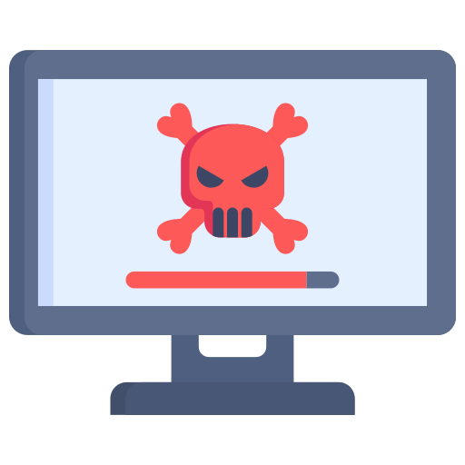
2. Malware
"Malware" is a short term for "malicious software." It refers to any type of software specifically designed to harm, exploit, or gain unauthorized access to computer systems, networks, or devices. Malware can take various forms, such as viruses, worms, Trojans, ransomware, spyware, adware, and more. Its primary purpose is to cause damage, steal sensitive information, disrupt operations, or perform other harmful actions without the user's knowledge or consent.
There are several common ways that malware can attack computer systems and networks. Those are infected downloads, USB and removable media, email attachments, file sharing and peer-to-peer networks, and torrent and cracked software.

Slide 11
Preventive Measures Of Malware Attack
Use reputable antivirus and anti-malware software.
Keep all software and operating systems updated.
Be cautious with email attachments and links from unknown sources.
Download software and apps only from trusted sources.
Secure your network with a strong password and encryption.
Regularly back up your important data.
Use strong, unique passwords for all accounts.
Educate yourself about social engineering tactics.

Slide 12
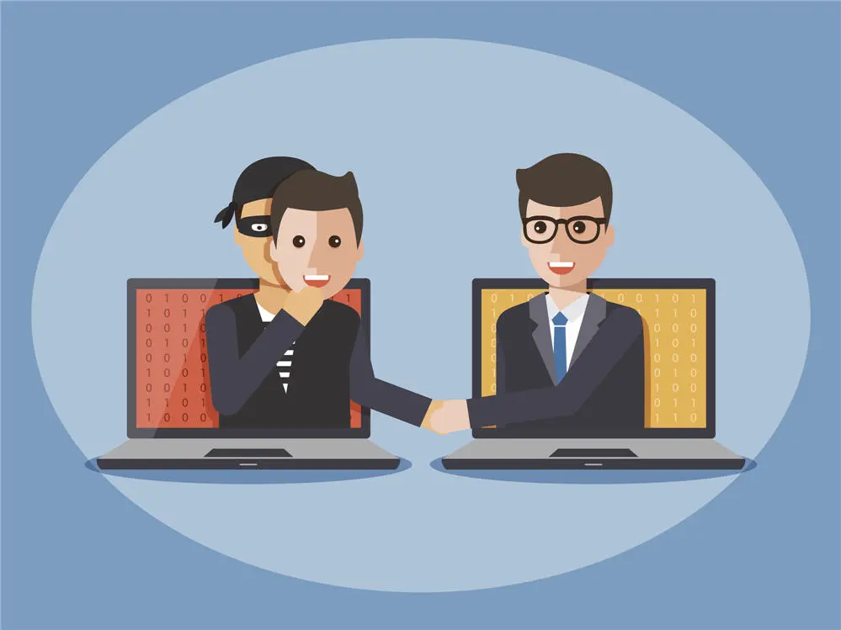
3. Identity Theft
Identity theft is a type of crime in which an individual's personal information is stolen and used by someone else for fraudulent purposes. The stolen information may include the person's name, address, Social Security number, date of birth, credit card details, bank account numbers, and other sensitive data. The identity thief uses this stolen information to impersonate the victim, essentially assuming their identity to conduct various illicit activities.

Slide 13
Preventive Measures Of Identity Theft
Secure personal information and documents.
Use strong passwords and enable MFA.
Beware of phishing attempts and unsolicited requests.
Avoid public Wi-Fi for sensitive activities.
Monitor financial accounts regularly.
Shred documents with personal information.
Be cautious with personal data online.
Consider freezing credit reports.
Limit sharing of personal information.

Slide 14
4. Password Attacks
Attackers use various methods to obtain passwords, such as brute force (trying all possible combinations), dictionary attacks (trying common words), or leveraging stolen passwords from data breaches. Example of easy passwords are
- 12345
- Password
- YourBirthday
- YourName123
- YourMobileNumber
- StudentIdNumber
- PetName
- BestFriendName
- FamillyMembersName
- RelagiousKeywords

Slide 15
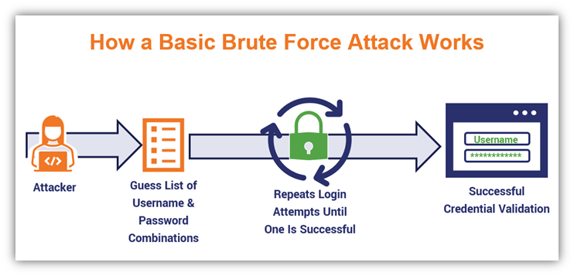
Brute-force attack
A brute-force attack is a type of password attack where hackers make numerous hit-or-miss attempts to gain access. It is a simple attack and often involves automated methods, such as software, for trying multiple letter-number variations.
Employing an extensive number of possibilities takes a long time, so attackers must look for efficiencies. To generate a list of potential combinations, they often start with easy choices, such as common or short passwords. If they know the password requirements for a specific provider (such as the minimum number of characters accepted), the attackers will apply those criteria as well

Slide 16
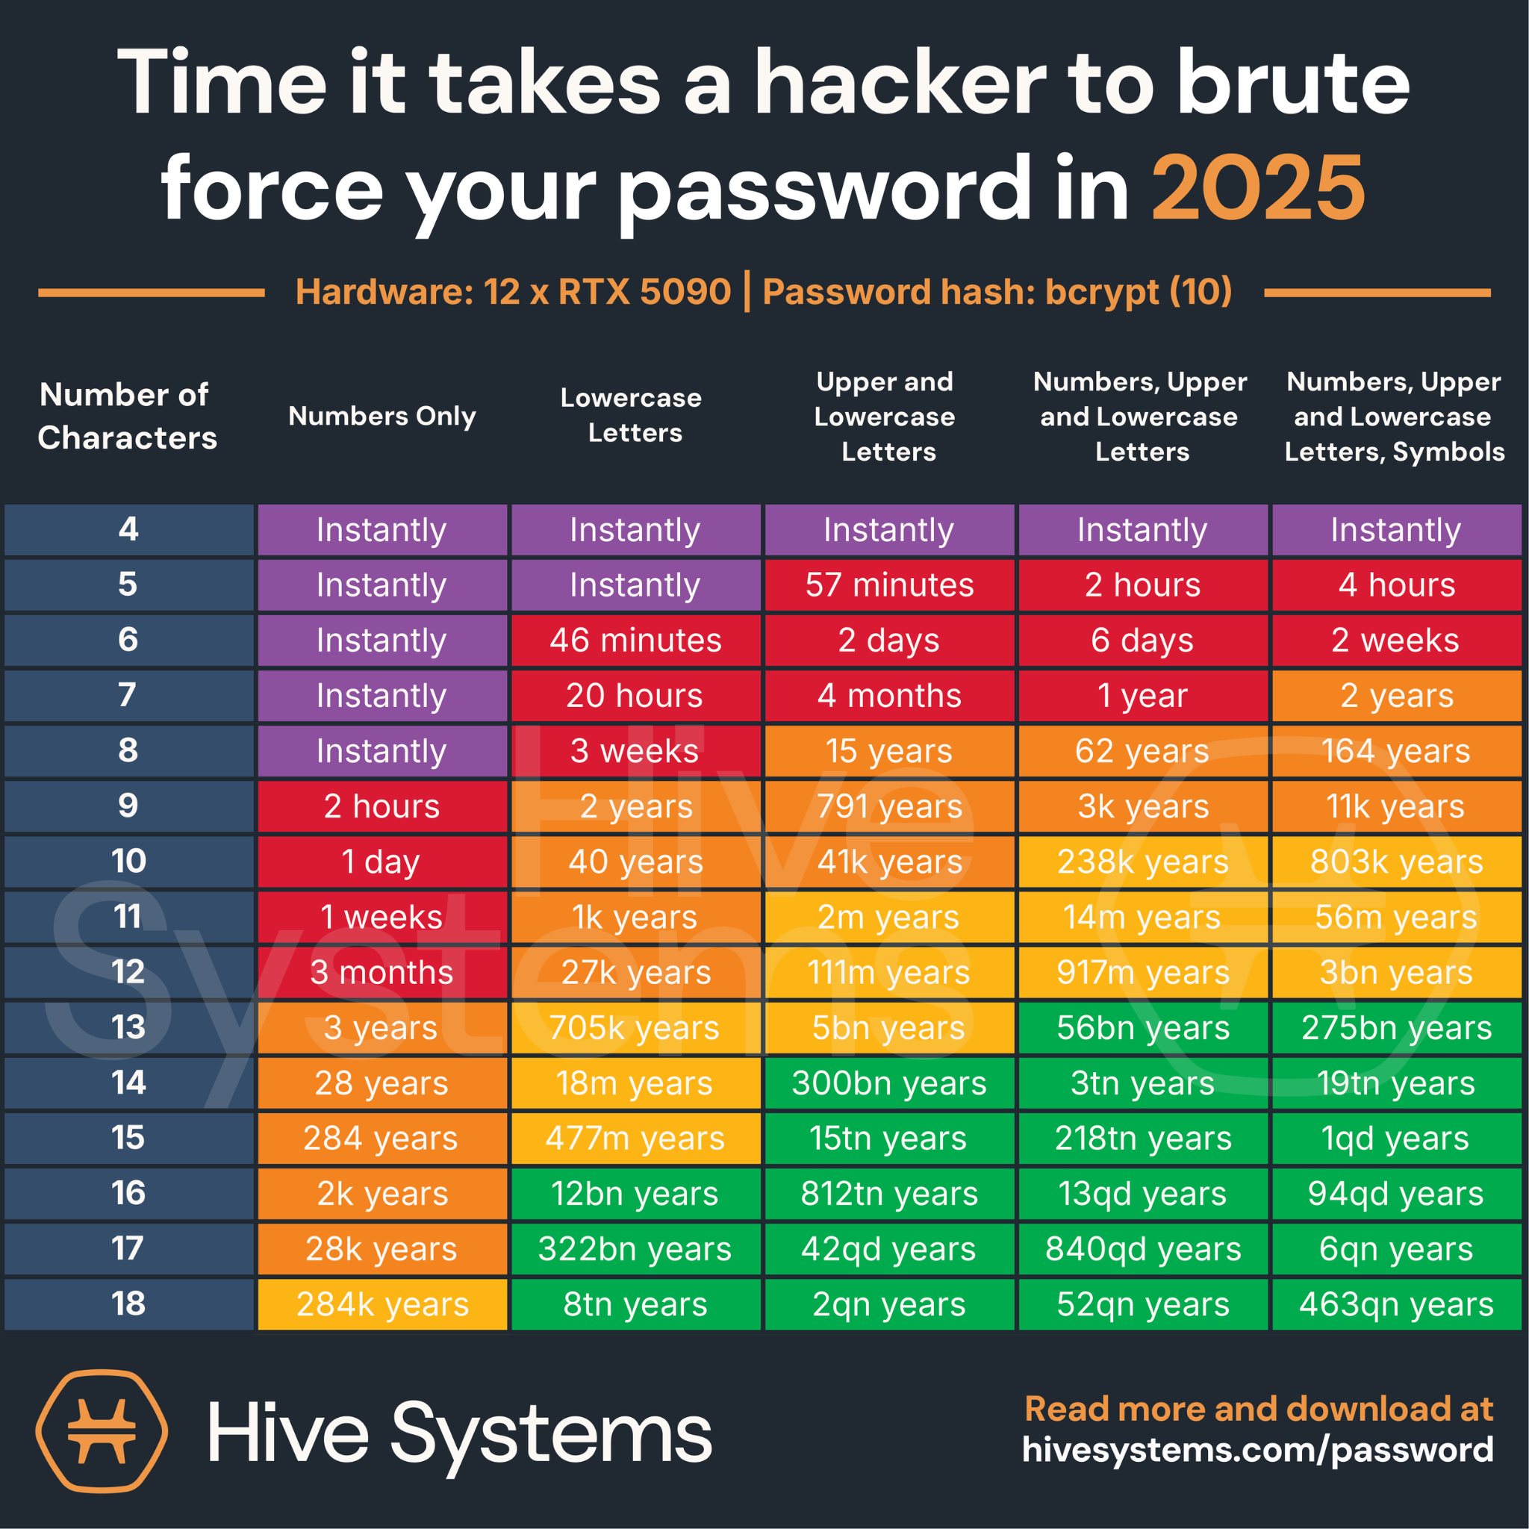

Slide 17
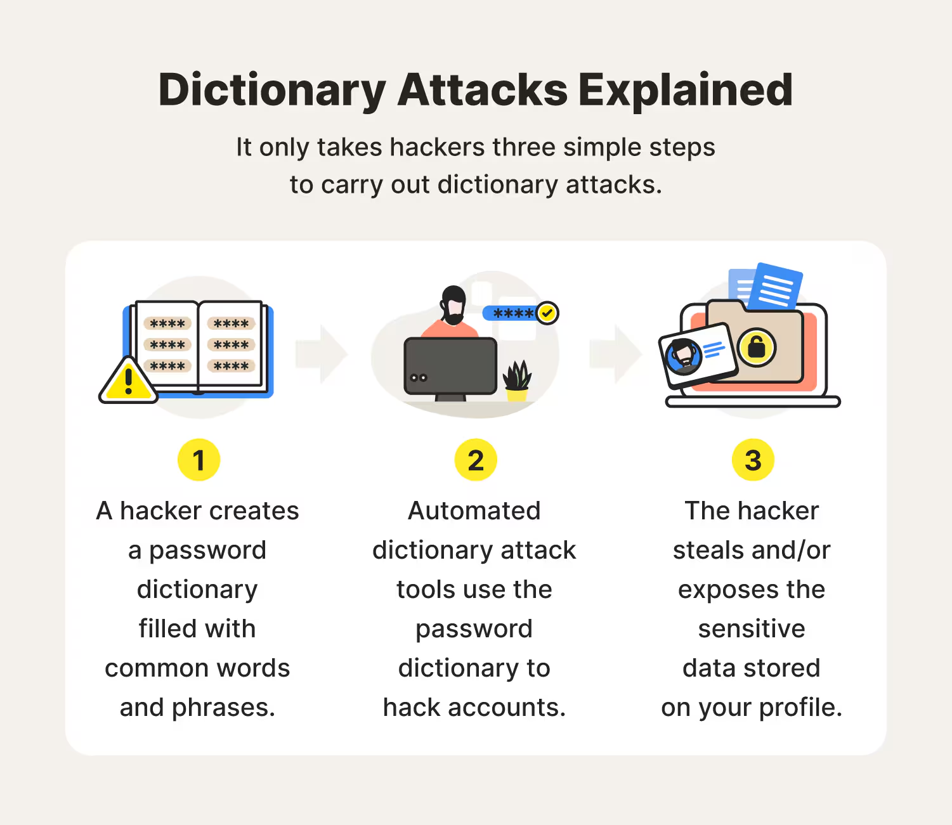
Dictionary attack
A type of brute-force password attack, a dictionary attack is based on a list of commonly used words and phrases, as well as often-used passwords. To avoid having to crack a long list of possible passwords, attackers narrow down the list to what's known as dictionary words.
Those words are not limited to actual words in the dictionary. They could also include popular names of pets, movie characters, and people. Hackers will also utilize variations by appending letters with numbers and special characters (e.g., substituting the letter O with the number 0).
It only takes hackers three simple steps to carry out dictionary attacks

Slide 18
Preventive Measures Of Password Attacks
Use strong password
least 12 characters long
!, @, #, $, %, etc.). mixing different types of characters
Avoid personal information . e.g., Name, birthday.
Avoid common patterns. e.g., 123456 or abcdefg
Use password manager
Regularly change passwords

Slide 19
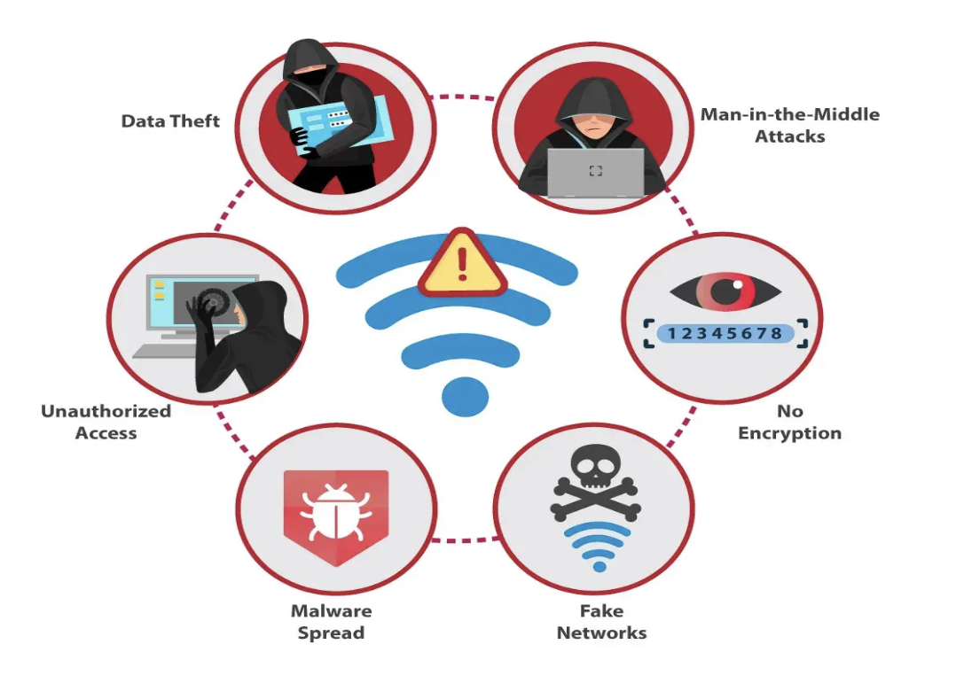
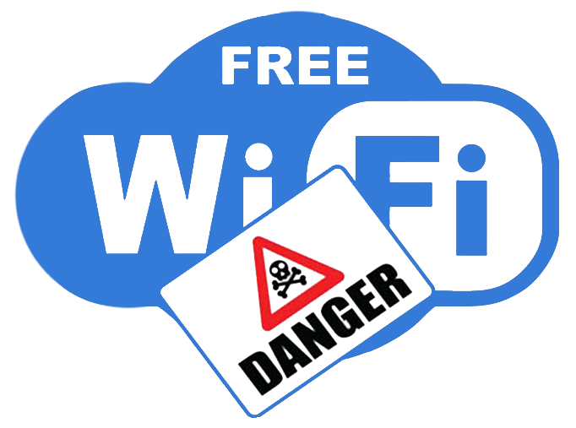
5. Public Wi-Fi Risks
Unsecured public Wi-Fi networks expose users to potential data interception and man-in-the-middle attacks, where attackers intercept communication between two parties.
Risks of public wifi usage

Slide 20
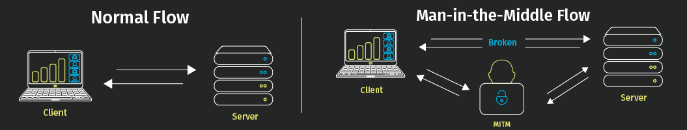
Public Wi-Fi Risks
A Man-in-the-Middle (MITM) attack is a type of cyberattack where a malicious actor secretly intercepts, alters, or relays communication between two parties (e.g., a client and a server) who believe they are communicating directly with each other.

Slide 21
Preventive Measures Of Public Wi-Fi Risks
Use secure and encrypted connections (HTTPS) whenever possible
Avoid connecting to unsecured or public Wi-Fi networks
Verify the authenticity of websites and digital certificates
Use VPN (Virtual Private Network) for added security
Be cautious of unexpected or unusual website behavior

Slide 22
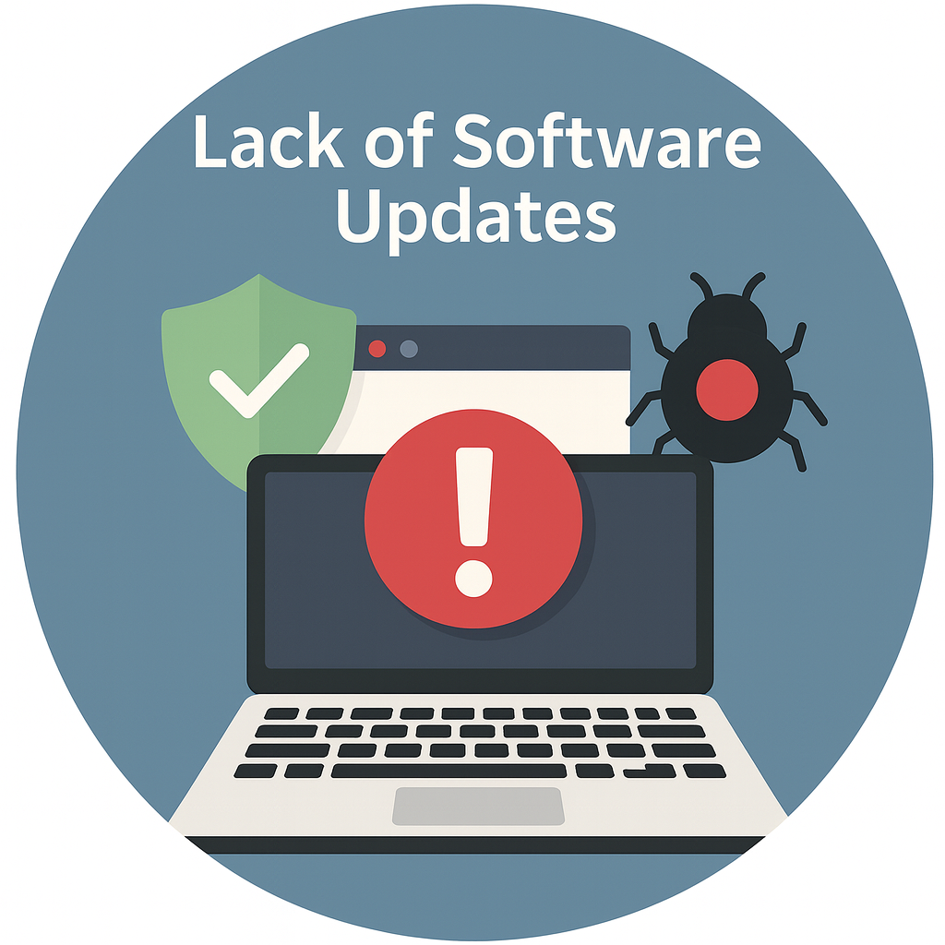
6. Lack of Software Updates
Failing to update software and operating systems can leave devices vulnerable to known exploits and security risks. Updating software can prevent these types of attacks.
A software update, also known as a ‘patch,’ is a set of changes made to a software program that is already installed on a computer or other device. These changes fix bugs, improve performance, add new features, or address security vulnerabilities. Updates are typically delivered electronically by the software vendor and can be installed manually or automatically.

Slide 23

7. Fake Apps and Software
Fake apps are apps that appear legitimate at first glance but actually have malicious features or intentions. Many are designed to closely resemble genuine, successful apps, with very similar names and icons, in order to trick the user into downloading and running them. Others may claim to have simple, useful functions but could actually infect your device or steal your data.
Downloading applications or software from unofficial sources can result in installing malware or compromised software on devices.

Slide 24
Preventive Measures Of Fake Apps and Software
Update your mobile devices
Guard your personal information
Think before you app
Update your mobile device
Protect your money
When in doubt, don’t respond
Stay informed

Slide 25
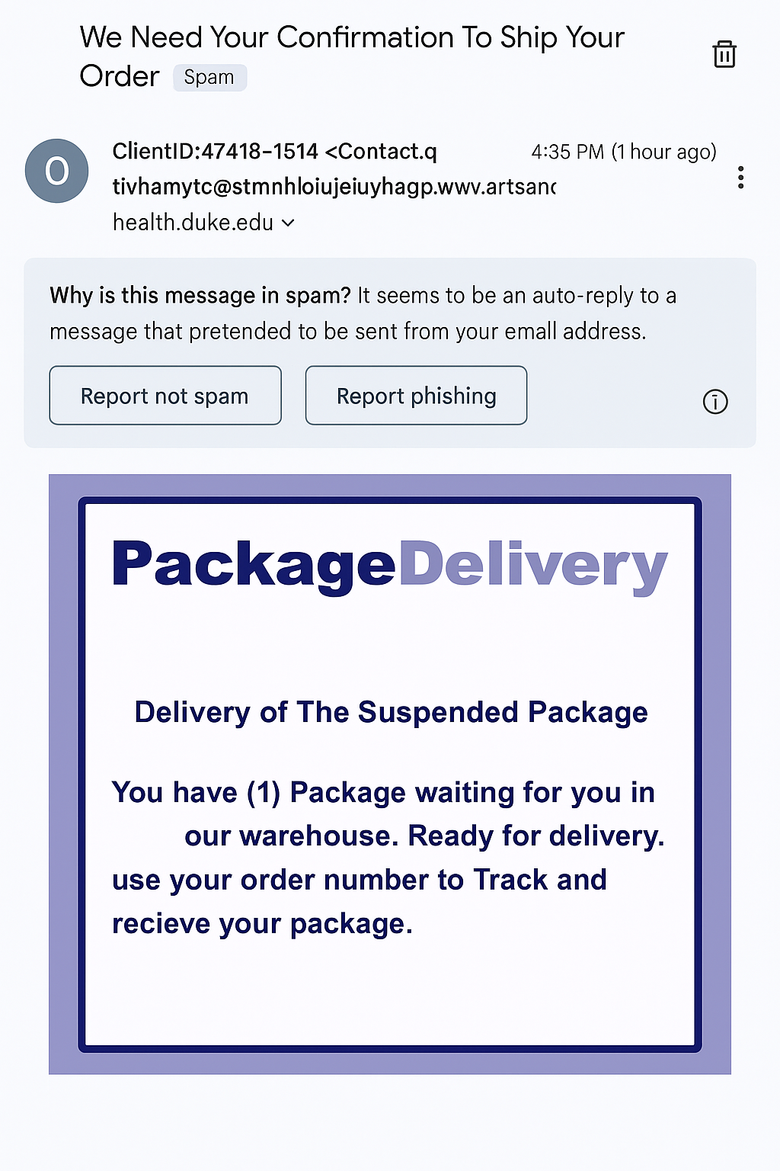
8. Scams
In information security, a scam refers to a fraudulent scheme designed to trick individuals or organizations into revealing sensitive information, transferring money, or giving attackers access to systems. Scams exploit human trust and weaknesses rather than purely technical flaws.
Scammers use various schemes, like fake online stores, lottery scams, and charity fraud, to deceive individuals into providing money or personal information.

Slide 26
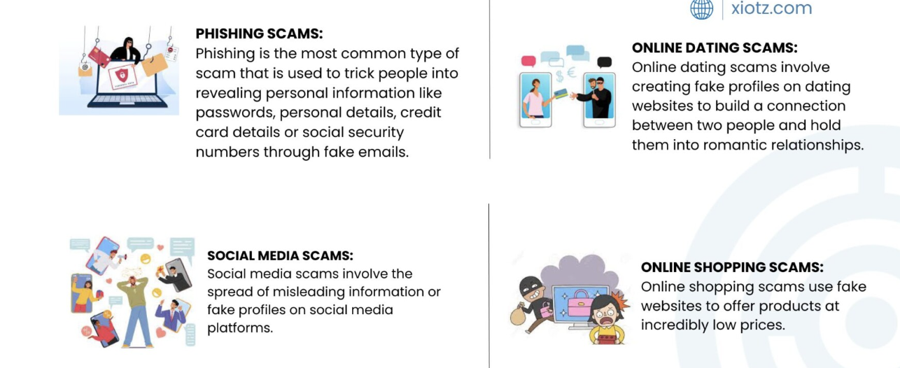
Types of Scams

Slide 27
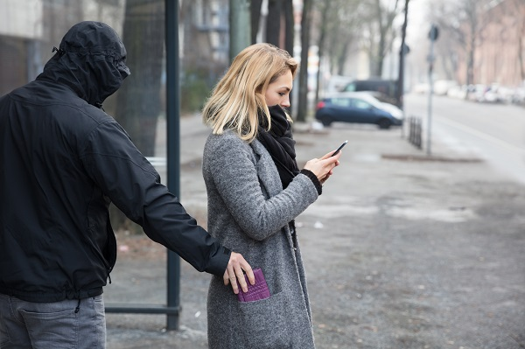
9. Physical Theft of Devices
Physical theft of personal devices involves the act of stealing a device, such as a phone, laptop, or hard drive, to gain access to the data stored on it. To prevent this, take steps to control access to your devices, use strong passwords or biometrics, lock devices when not in use, encrypt sensitive data, and report stolen devices to the police immediately.

Slide 28
Thank you.

